Slide 1
Boolean Expressions forms and simplification

Slide 2
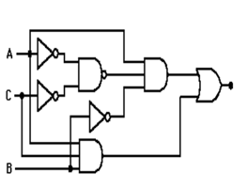
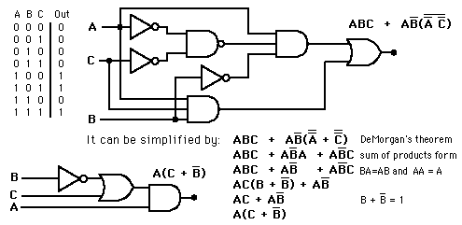
Example
Simplification of logic circuits using Algebraic method (use Boolean algebra theorems)
For the given logic circuit: a) Write the Boolean expression for the original circuit . b) Simplify the Boolean expression. c) Draw the simplified circuit .

Slide 3
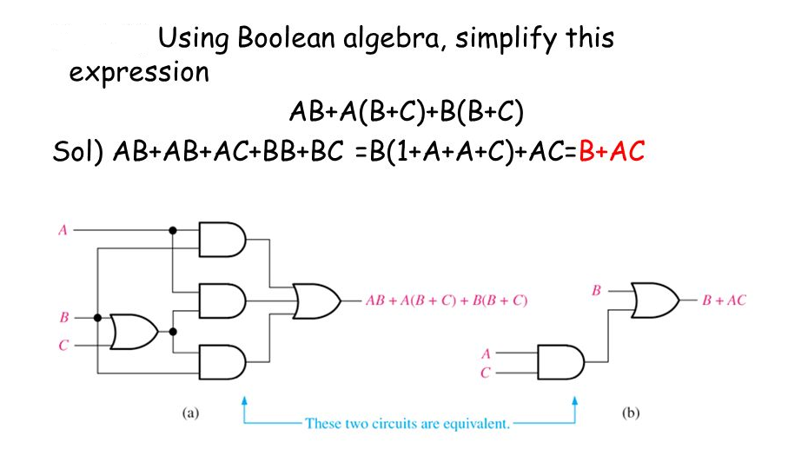
Example

Slide 4
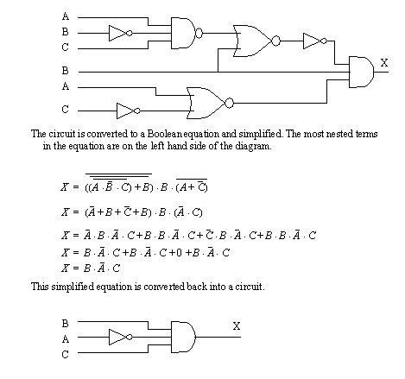
Example

Slide 5
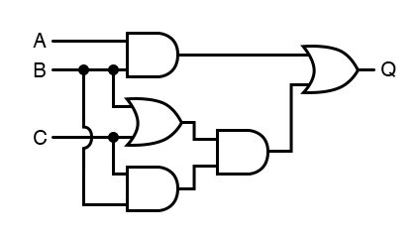
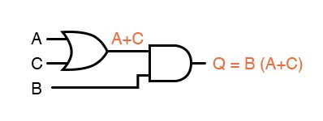
Example

Slide 6
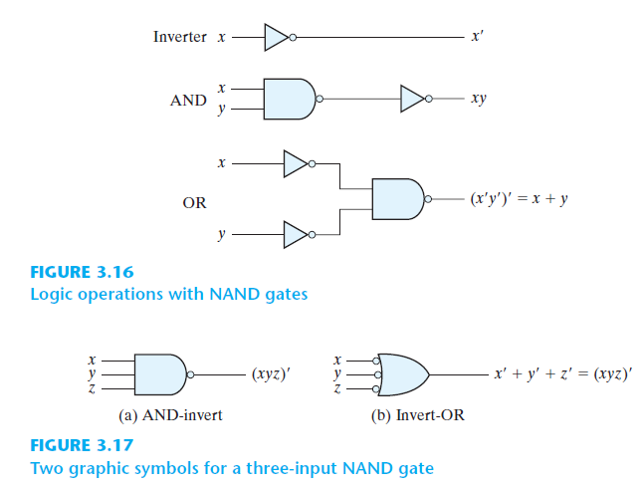
NAND AND NOR IMPLEMENTATION

Slide 7
Example
Express the Boolean function F = x y + x’ z as a product of max-terms.
F = xy + x’z = (xy + x’)(xy + z) Distributive law
= (x + x’)(y + x)(x + z)(y + z)
= (x + y)(x + z)(y + z)

Slide 8
Problem and Discussion
Q.1. Express the following function in sum of min-terms and product of max-terms:
F(A,B,C,D)= B’D+A’D+BD
Sol.

Slide 9
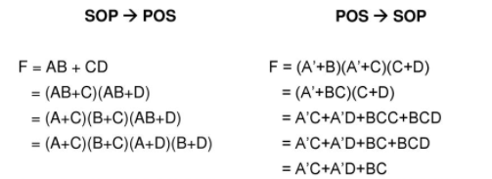
SOP/POS Conversion

